Slide 1
MSSQL Curriculum(Duration 3-4 weeks) Data Definition Language (DDL)
RDBMS (Relational Database Management System) Introduction
Normalization in RDBMS
Create database objects i.e. Create Table
Delete database objects i. e. Delete Database
Alter database objects i.e. Change Column Name
Create, alter and delete constraints
Data types in Sql
Alter table statement
Drop Table statement
Various constraints

Slide 2
Hands-on/Demo/Use-case:
Create Table With Predefine Columns
Add New Column to Existing Table
Check the constraints on a table
Add Primary Key and Foreign Key on Table
Remove Unique Constraint

Slide 3
DML (Data Manipulation Language)
Insert Statements
Insert – As- Select Statement
Update Statements
Delete Statements
Truncate Statements
Select Statement
Sorting and Filtering
SQL wildcard

Slide 4
Hands-on/Demo/Use-case:
Insert the records in an existing table
Delete selective records
Update data in the table based on data from another table
Truncate Vs Delete
Having vs Where clause

Slide 5
Inbuilt Functions in SQL
Group by
Conversion Function
Logical Functions
Math Function
Aggregate Functions
String Functions
Date Functions
Operators
Sub queries
Joins
CASE Expression

Slide 6
Retrieve data from multiple tables
Self-Join
Inner Join
Left Join
Right Join
Full Join
Cross Join
Union and Union all
Creating views

Slide 7
Programming in SQL
RANK,DENSE_RANK,ROW_NUMBER,NTILE
Derived table,Table Variables and Temporary tables
Common Table expression(CTE)
Recursive CTE
Merge concept
Output clause
Create Functions
Create Triggers
Create and Execute Stored Procedure
Transactions
Isolation levels
Error handling

Slide 8
Indexes
Clustered
Non Clustered
Filter Index
Covering Index
Performance Tuning of SQL Programs
Best Practises
Tips and Tricks while programming.

Slide 9
Topics
Introduction to SQL, RDBMS
Commands DDL,DML,DCL,TCL,DQL
Constraints- Primary key, Foreign Key, Unique, Not Null
SET operations Union, Union all, except ,intersect
Joins
Ranking functions

Slide 10
RDBMS
Database
A database is a set of data stored in a computer. This data is usually structured in a way that makes the data easily accessible.
Relational Database
A relational database is a type of database. It uses a structure that allows us to identify and access data in relation to another piece of data in the database. Often, data in a relational database is organized into tables.
Relational Database Management System (RDBMS)
A relational database management system is a program that allows you to create, update, and administer a relational database. Most relational database management systems use the SQL language to access the database.

Slide 11
Here is the list of top 10 most popular RDBMSs :
Oracle*
MySQL
SQL Server
PostgreSQL
IBM DB2*
Microsoft Access
SQLite
MariaDB
Informix
Azure SQL

Slide 12
History of SQL server
Version | Year | Release
- | 1999 | SQL Server 7.0 OLAP Tools
1.0 (OS/2) | 1989 | SQL Server 1.0 (16-bit)
1.1 (OS/2) | 1990 | SQL Server 1.1 (16-bit)
4.2A (OS/2) | 1992 | SQL Server 4.2A
4.2B (OS/2) | 1993 | SQL Server 4.2B (16-bit)
4.21a (WinNT) | 1993 | SQL Server 4.21a
6 | 1995 | SQL Server 6.0
6.5 | 1996 | SQL Server 6.5
7 | 1998 | SQL Server 7.0
8 | 2000 | SQL Server 2000
8 | 2003 | SQL Server 2000 64-bit Edition
9 | 2005 | SQL Server 2005
10 | 2008 | SQL Server 2008
10.25 | 2010 | Azure SQL database (initial release)
10.5 | 2010 | SQL Server 2008 R2
11 | 2012 | SQL Server 2012
12 | 2014 | Azure SQL database
12 | 2014 | SQL Server 2014
13 | 2016 | SQL Server 2016
14 | 2017 | SQL Server 2017
15 | 2019 | SQL Server 2019 RC

Slide 13
SQL server Components
SQL Server works in client-server architecture, hence it supports two types of components − (a) Workstation and (b) Server.
Workstation components are installed in every device/SQL Server operator’s machine. These are just interfaces to interact with Server components. Example: SSMS, SSCM, Profiler, BIDS, SQLEM etc.
Server components are installed in centralized server. These are services. Example: SQL Server, SQL Server Agent, SSIS, SSAS, SSRS, SQL browser, SQL Server full text search etc.

Slide 14
Instance of SQL Server
Instance of SQL Server
An instance is an installation of SQL Server.
An instance is an exact copy of the same software.
If we install 'n' times, then 'n' instances will be created.
There are two types of instances in SQL Server a) Default b) Named.
Only one default instance will be supported in one Server.
Multiple named instances will be supported in one Server.
Default instance will take the server name as Instance name.
Default instance service name is MSSQLSERVER.
16 instances will be supported in 2000 version.
50 instances will supported in 2005 and later versions.

Slide 15
Advantages of Instances
Advantages of Instances
To install different versions in one machine.
To reduce cost.
To maintain production, development, and test environments separately.
To reduce temporary database problems.
To separate security privileges.
To maintain standby server.

Slide 16
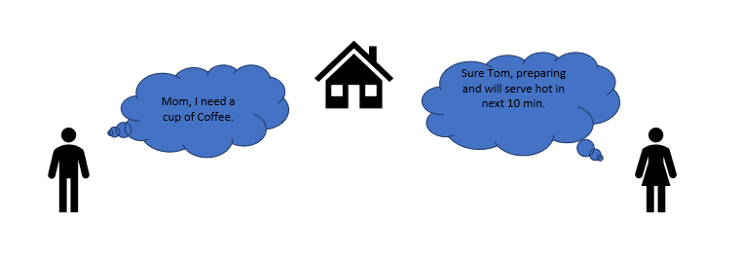
Client-Server Architecture

Slide 17
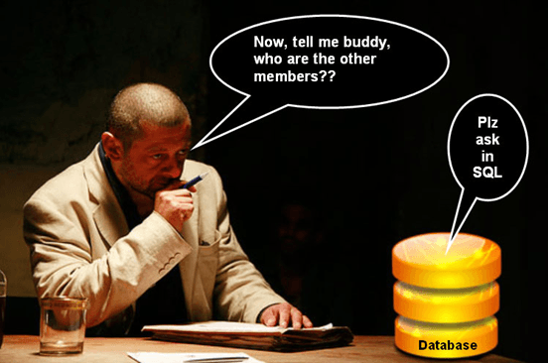
What is SQL?
SQL stands for Structured Query language, pronounced as "S-Q-L" or sometimes as "See-Quel". SQL is the standard language for dealing with Relational Databases. SQL can be used to insert, search, update and delete database records. SQL can do lots of other operations including optimizing and maintenance of databases. Relational databases like MySQL Database, Oracle, Ms SQL server, Sybase, etc uses SQL.

Slide 18
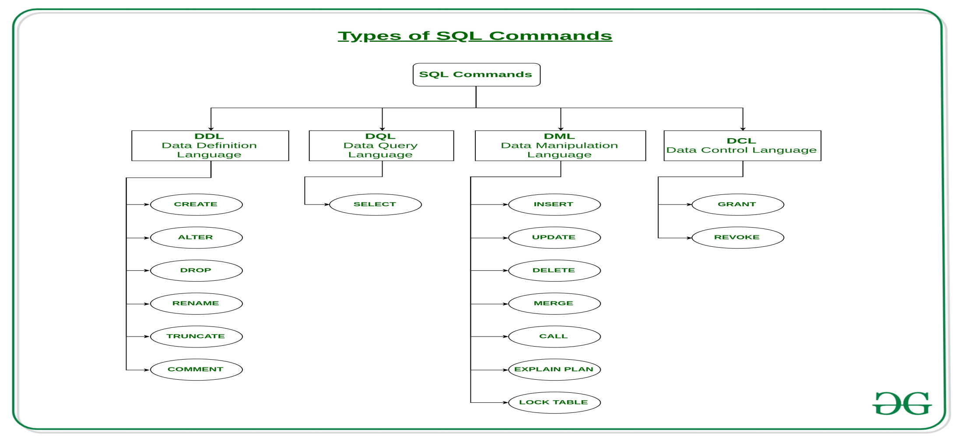
SQL | DDL, DQL, DML, DCL and TCL Commands Reference link:https://www.geeksforgeeks.org/sql-ddl-dql-dml-dcl-tcl-commands/

Slide 19
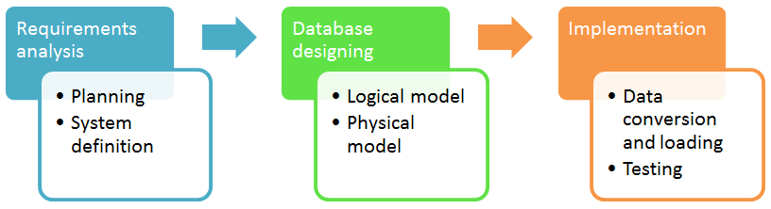
Database development life cycle

Slide 20
Database development life cycle
Requirements analysis
Planning - This stages concerns with planning of entire Database Development Life Cycle It takes into consideration the Information Systems strategy of the organization.
System definition - This stage defines the scope and boundaries of the proposed database system.
Database designing
Logical model - This stage is concerned with developing a database model based on requirements. The entire design is on paper without any physical implementations or specific DBMS considerations.
Physical model - This stage implements the logical model of the database taking into account the DBMS and physical implementation factors.
Implementation
Data conversion and loading - this stage is concerned with importing and converting data from the old system into the new database.
Testing - this stage is concerned with the identification of errors in the newly implemented system .It checks the database against requirement specifications.

Slide 21
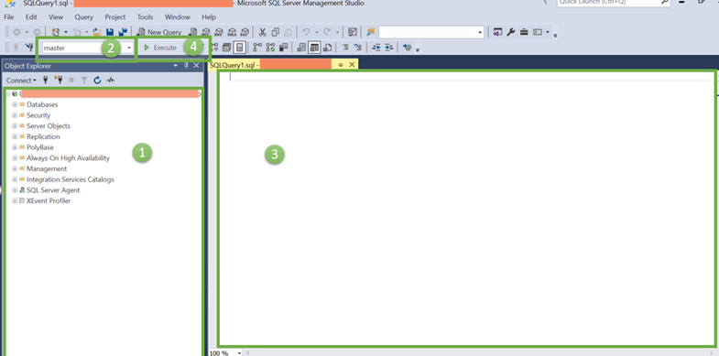
SQL SERVER MANAGEMENT STUDIO

Slide 22
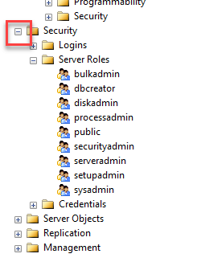
Object explorer Default key to open is F8

Slide 23
SQL SERVER MANAGEMENT STUDIO
2) Databases Selection Dropdown
This dropdown allows the user to select the Database in which we will be running our queries.
3) Query Editor
Here we can write all our queries. MS SQL server provides interactive suggestions for tables, columns, etc. for easy queries creations and much more.
4) Execute button
This button will finally execute the query and return the results.

Slide 24
DATABASE and Types of Databases in SQL Server
A database is a collection of objects such as tables, views, stored procedures, triggers, functions, etc.
There are two types of databases in SQL Server:
System database : used to store system-wide data and metadata.
User database: created by users who have the appropriate level of permissions to store application data.
Types of System databases:
Master
Model
Msdb
Tempdb
Resourcedb(Hidden and ReadOnly)
Reportserverdb
Reportservertempdb

Slide 25
SQL Server Database: Create, Alter, Drop, Restore
We can use both SQL Management GUI and T-SQL to perform all the three operations; Create, Alter and Delete Database.
A maximum of 32,767 databases can be specified on an instance of SQL Server.
System Databases cannot be deleted.
Create, Alter & Drop: All operations are case insensitive. We can use both upper and lower case as a syntax.
Reference link :https://www.guru99.com/sql-server-database-create-alter-drop-restore.html

Slide 26
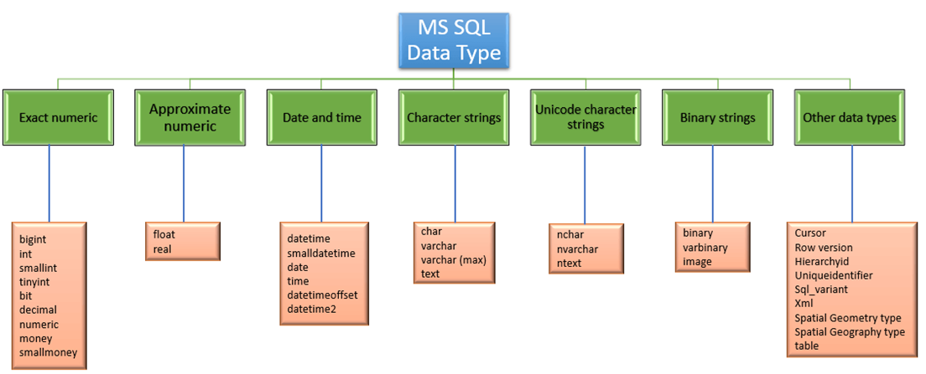
SQL Data types Reference link:https://www.guru99.com/sql-server-datatype.html

Slide 27
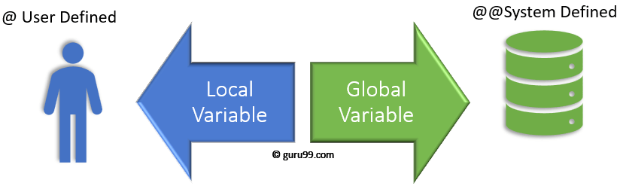
SQL Server Variable: Declare, Set, Select, Global,Local
What is Variable?
In MS SQL, variables are the object which acts as a placeholder to a memory location. Variable hold single data value.
Types of Variable: Local, Global
MS SQL has two types of variables:
Local variable
Global variable.

Slide 28
Hands on Variable concept
Global variables:
https://www.codeproject.com/Articles/39131/Global-Variables-in-SQL-Server

Slide 29
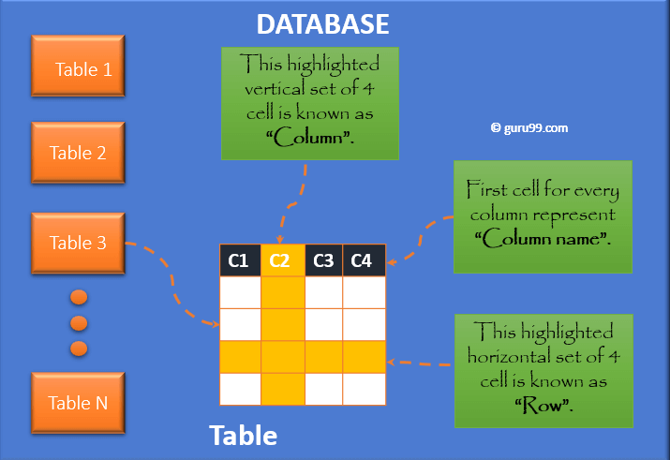
SQL Server Table: CREATE, ALTER, DROP [T-SQL Examples]

Slide 30
Primary key
What is a Primary Key?
A Primary Key is a field or a combination of fields that identify a record uniquely. The Primary key is a column or set of columns which are unique. In other words, every value is unique for Primary Key.
Rules for Primary Key
Each table can have only one Primary Key.
All the values are unique and Primary key value can uniquely identify each row.
The system will not allow inserting a row with a primary key which already exists in the table.
Primary Key cannot be NULL.

Slide 31
T-SQL - INSERT Statement
INSERT INTO TABLE_NAME [(column1, column2, column3,...columnN)]
VALUES (value1, value2, value3,...valueN);
INSERT INTO TABLE_NAME VALUES (value1,value2,value3,...valueN);
INSERT INTO first_table_name
SELECT column1, column2, ...columnN
FROM second_table_name
[WHERE condition];

Slide 32
T-SQL - SELECT Statement
SELECT column1, column2, columnN FROM table_name;
SELECT * FROM table_name;

Slide 33
T-SQL - WHERE Clause
SELECT column1, column2, columnN
FROM table_name
WHERE [condition]

Slide 34
T-SQL - LIKE Clause
The MS SQL Server LIKE clause is used to compare a value to similar values using wildcard operators.
There are two wildcards used in conjunction with the LIKE operator
The percent sign (%)
The underscore (_)
The percent sign represents zero, one, or multiple characters. The underscore represents a single number or character. The symbols can be used in combinations.

Slide 35
T-SQL - ORDER BY Clause
SELECT column-list
FROM table_name
[WHERE condition]
[ORDER BY column1, column2, .. columnN] [ASC | DESC];

Slide 36
T-SQL - GROUP BY Clause
SELECT column1, column2
FROM table_name
WHERE [ conditions ]
GROUP BY column1, column2
ORDER BY column1, column2

Slide 37
T-SQL - DISTINCT Clause
SELECT DISTINCT column1, column2,.....columnN
FROM table_name
WHERE [condition]

Slide 38
T-SQL - UPDATE Statement
UPDATE table_name
SET column1 = value1, column2 = value2...., columnN = valueN
WHERE [condition];

Slide 39
T-SQL - DELETE Statement
DELETE FROM table_name
WHERE [condition];

Slide 40
T-SQL - Drop Tables
DROP TABLE table_name;

Slide 41
Where conditions
Standard comparision operators
= , > , >= , < , <= , <> ,!=, !< ,!>
Using the Between
Select * from TableName where Colvalue between 10 and 19
(Result set will include both 10 and 19)
IN,NOT IN, SOME,ANY and ALL

Slide 42
Multiple WHERE conditions
Select * from TableName
Where
(condition1) or (condition2) and (condition3)

Slide 43
TOP()
Select Top(N) col1, col2, col3, …., colN from TableName
order by colx
Declare @var int
Set @var=n
Select top(@var) * from TableName
SELECT TOP 50 PERCENT * FROM Customers;

Slide 44
AutoGeneration numbers
ColumnName DataType Identity(1,1)

Slide 45
Insert data into primary key column
SET IDENTITY_INSERT TableName ON
SET IDENTITY_INSERT TableName OFF

Slide 46
Foreign key
A foreign key provides a way of enforcing referential integrity within SQL Server. In simple words, foreign key ensures values in one table must be present in another table.
Rules for Foreign key
NULL is allowed in Foreign key.
The table being referenced is called the Parent Table
The table with the foreign key is called Child Table.
The foreign key in child table references the primary key in the parent table.
This parent-child relationship enforces the rule which is known as "Referential Integrity."

Slide 47
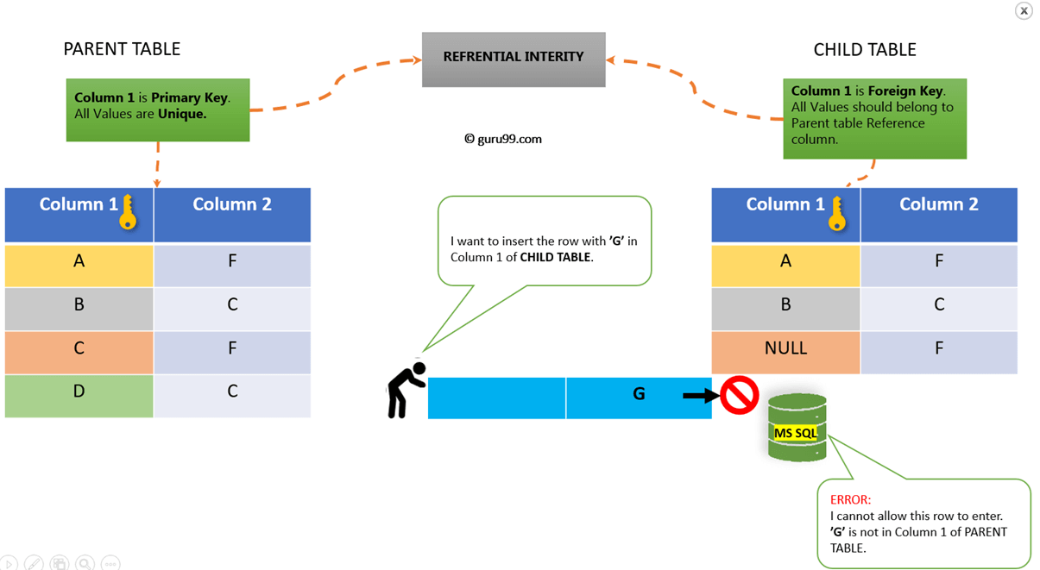
Foreign key

Slide 48
Foreign key
CREATE TABLE childTable
(
column_1 datatype [ NULL |NOT NULL ],
column_2 datatype [ NULL |NOT NULL ],
...
CONSTRAINT fkey_name
FOREIGN KEY (child_column1, child_column2, ... child_column_n)
REFERENCES parentTable (parent_column1, parent_column2, ... parent_column_n)
[ ON DELETE { NO ACTION |CASCADE |SET NULL |SET DEFAULT } ]
[ ON UPDATE { NO ACTION |CASCADE |SET NULL |SET DEFAULT } ]
);

Slide 49
Constraints in SQL Server
A constraint is a property assigned to a column or the set of columns in a table that prevents certain types of inconsistent data values from being placed in the column(s). Constraints are used to enforce the data integrity. This ensures the accuracy and reliability of the data in the database.
Microsoft SQL Server supports the following constraints:
Primary Key
Unique
Foreign key
check (limit the values that can be placed in a column)
Not null
Default (A default allows you to specify a constant value, NULL or the run-time value of a system function if no known value exists or if the column is missing in an INSERT statement)

Slide 50
Constraints
ALTER TABLE table_name
ADD CONSTRAINT MyUniqueConstraint UNIQUE(column1, column2...);
ALTER TABLE table_name alter column Colname datatype NOT NULL;
ALTER TABLE table_name ADD CONSTRAINT CHKconstraintName CHECK (condition);

Slide 51
Drop constraints
ALTER TABLE TableName DROP CONSTRAINT ConstraintName

Slide 52
SQL Joins
A JOIN clause is used to combine rows from two or more tables, based on a related column between them.
Different Types of SQL JOINs
(INNER) JOIN: Returns records that have matching values in both tables
LEFT (OUTER) JOIN: Returns all records from the left table, and the matched records from the right table
RIGHT (OUTER) JOIN: Returns all records from the right table, and the matched records from the left table
FULL (OUTER) JOIN: Returns all records when there is a match in either left or right table

Slide 53
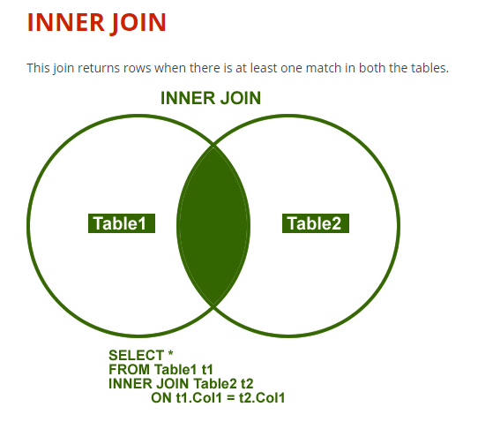
Inner Join

Slide 54
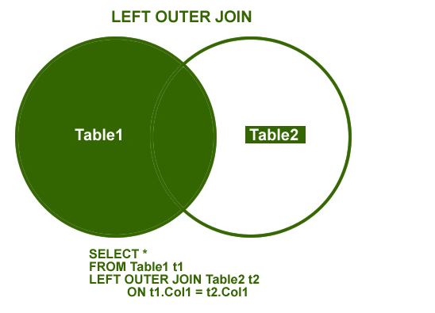
Left Outer Join

Slide 55
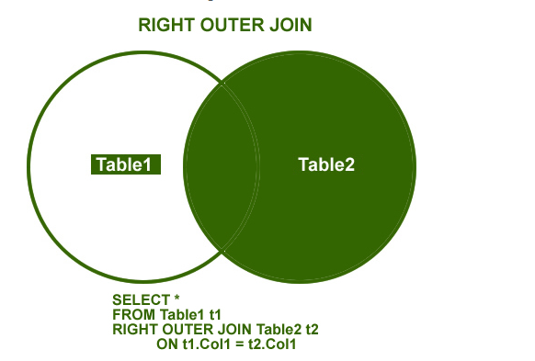
Right outer join

Slide 56
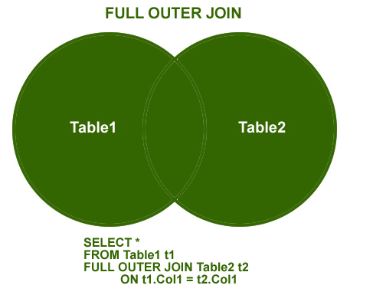
Full Outer Join

Slide 57
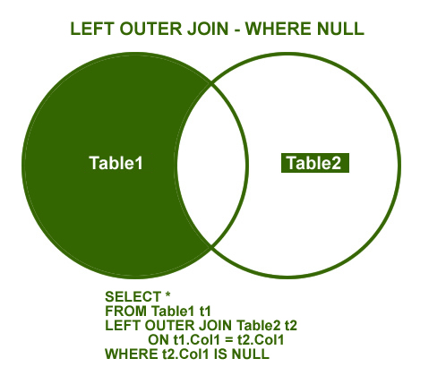
Left Join where NULL

Slide 58
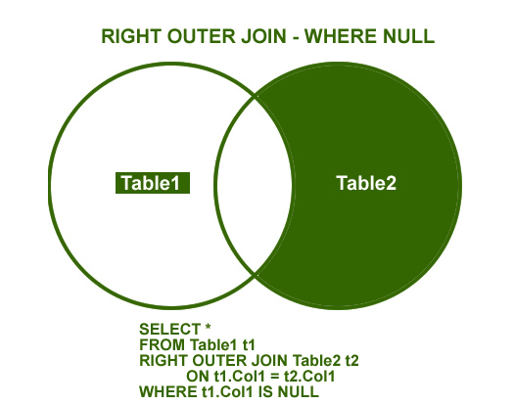
Right Join where NULL

Slide 59
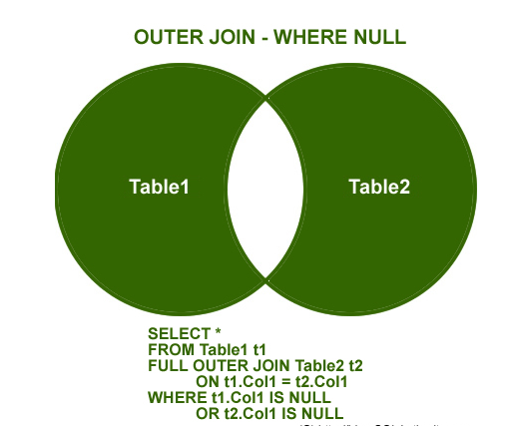
Full outer join where NULL

Slide 60
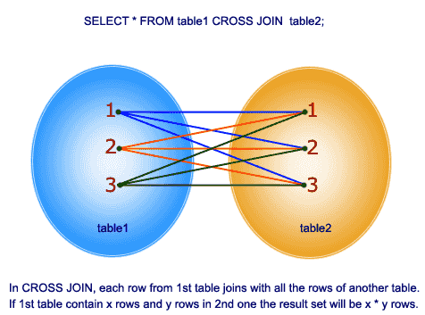
Cross Join

Slide 61
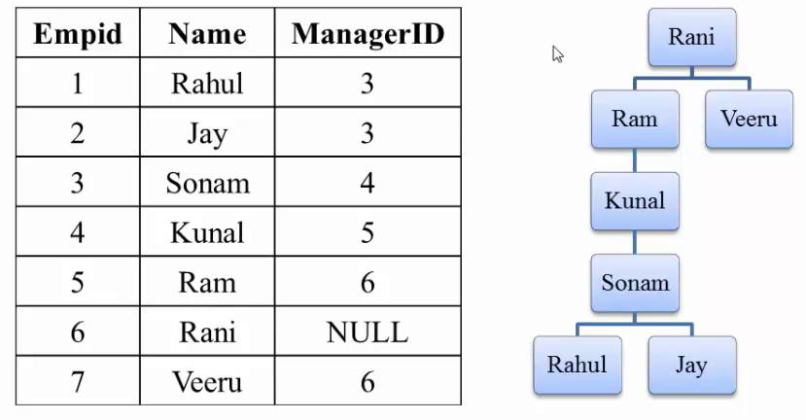
SQL Self JOIN
Self join is a table joined to itself

Slide 62
Avoid select *
It is a waste of resources, In most cases data is returned than needed
Adding a column to the table could potentially break the application
If select * is used in the query, usage of covering index will be of no use

Slide 63
SELECT INTO Statement
SELECT *
INTO newtable [IN externaldb]
FROM oldtable
WHERE condition;
SELECT column1, column2, column3, ...
INTO newtable [IN externaldb]
FROM oldtable
WHERE condition;

Slide 64
Union, Except and Intersect
Union ,Except and Intersect can be specified between two or more queries to provide a single result set.
Union-combines the result sets from the multiple queries into single result set
Except, Intersect- compares the result sets of two queries

Slide 65
Case Statement
CASE
WHEN condition1 THEN result1
WHEN condition2 THEN result2
WHEN conditionN THEN result
ELSE result
END;

Slide 66
Ranking Functions
Rank()
Dense Rank()
Row_number()- Generates an on the fly auto incrementing integer according to the sort order of the over() clause.
Ntile()- It will organize the rows in to n number of groups called tiles and returns the tile number
Ranking functions can be used only in select or in order by clause

Slide 67
Windowing Functions
Over()
Partitioning within the window
Windowing functions can be used not only for the four ranking functions but also can be used with the standard aggregate functions: count(*),Min(),max() and so on

Slide 68
THANK YOU

